Slide 1
Customer Sentiment Analysis for Marketing
By Anoushkaa Deepak Gavankar

Slide 2
Procedure:-
Solving the Business Problem
Cleaning Data with SQL for Insights – SQL Server Service Management Studio
Advanced Sentiment Analysis with Python – Visual Studio Code
Building an Interactive Dashboard – Power BI
Presenting Data to Stakeholders

Slide 3
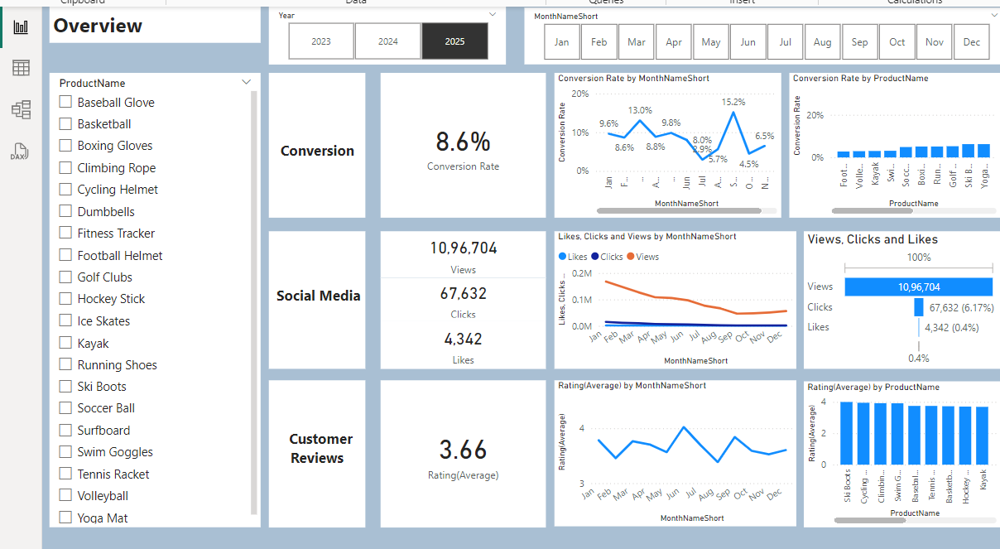
Overview
Conversion Rates
The conversion rate improved significantly in December, reaching 10.2%.
There was a noticeable dip in October, where it dropped to 5.0%.
2. Customer Engagement
Social media engagement has declined over the year, with views consistently dropping.
Although clicks and likes are lower than views, the click-through rate is at 15.37%, showing that
engaged users are still interacting well.
3. Customer Feedback
Customer ratings have stayed steady at an average of 3.7 throughout the year.
However, this is below the target rating of 4.0. Products rated below 3.5 need attention to improve customer satisfaction.

Slide 4
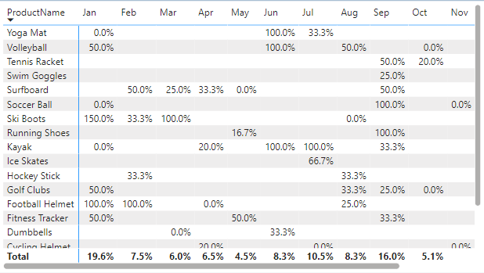
Decreased Conversion Rates
General Conversion Trend:
Throughout the year, conversion rates varied, with higher percentages observed in months like January (19.6%) and September (16%). This suggests that while some products had strong seasonal peaks, there is potential to improve conversions in lower-performing months through targeted interventions such as email campaigns, discounts, or social media promotions.
Lowest Conversion Month:
May experienced the lowest overall conversion rate at 4.5%, with no products standing out significantly in terms of conversion. This indicates a potential need to revisit marketing strategies or promotions during this period to boost performance. For example, exploring partnerships or running targeted advertising campaigns could be beneficial.
Highest Conversion Rates:
January recorded the highest overall conversion rate at 19.6%, driven significantly by Ski Boots with a remarkable 150% conversion rate. This indicates a strong start to the year, likely fueled by seasonal demand and effective marketing strategies. Analyzing the specific tactics used in January, such as promotional bundling or targeted advertising, could provide insights for application in other months.

Slide 5
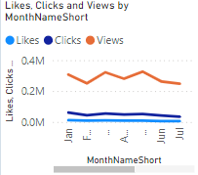
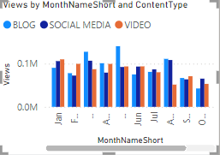
Reduced Customer Engagement
Declining Views:
Views remained high overall, with minor fluctuations across months. There was a consistent peak in February and July, followed by a slight decline in later months.
Low Interaction Rates:
Clicks and likes stayed consistently low throughout the months compared to views. This indicates the need for better engagement strategies, such as interactive content or compelling calls to action.
Content Type Performance:
Blog content consistently drove the most views, especially in February and July.Social media and video content maintained steady engagement levels but trailed slightly behind blogs in overall performance.

Slide 6
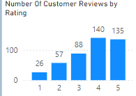
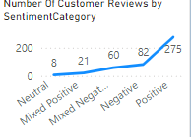
Customer Feedback Analysis
Customer Ratings Distribution:
The majority of customer reviews are highly positive, with 140 reviews at 4 stars and 135 reviews at 5 stars, showcasing strong customer approval. Ratings of 1 star (26 reviews) and 2 stars (57 reviews) account for a smaller proportion, indicating limited dissatisfaction.
Sentiment Analysis:
Positive sentiment dominates with 275 reviews, highlighting a very satisfied customer base. Negative sentiment is present in 82 reviews, while smaller counts are observed for Neutral (8 reviews), Mixed Positive (21 reviews), and Mixed Negative (60 reviews), suggesting specific areas of improvement.
Opportunity for Improvement:
The Mixed Positive and Mixed Negative reviews highlight opportunities to address customer concerns and enhance satisfaction. Resolving these issues could further increase the number of highly positive reviews and sentiments, thereby boosting overall customer satisfaction.

Slide 7
Goals & Actions
GOALS:-
Actions:-
Increase Conversion Rates:
Goal: Identify factors impacting the conversion rate and provide recommendations to improve it.
Insight: Highlight key stages where visitors drop off and suggest improvements to optimize the conversion funnel.
Enhance Customer Engagement:
Goal: Determine which types of content drive the highest engagement.
Insight: Analyze interaction levels with different types of marketing content to inform better content strategies.
Improve Customer Feedback Scores:
Goal: Understand common themes in customer reviews and provide actionable insights.
Insight: Identify recurring positive and negative feedback to guide product and service improvements.
Increase Conversion Rates:
Target High-Performing Product Categories:
Focus marketing on products that have shown strong sales, like Kayaks, Ski Boots, and Surf Boards. Run special promotions or personalized campaigns during busy months, such as January and September, to make the most of these trends.
Enhance Customer Engagement:
Revitalize Content Strategy:
To increase views and interaction, experiment with more engaging formats like interactive videos or user-created content. Also, improve engagement by placing effective prompts in social media and blog posts, especially during months with lower interaction (September to December)
Improve Customer Feedback Scores:
Address Mixed and Negative Feedback:
Set up a system to review and analyze negative feedback to find common problems. Create plans to fix these issues. Consider reaching out to unhappy customers to solve their problems and ask them to update their ratings, with the goal of improving the average rating to around 4.0.

Slide 8
Thankyou!

